Slide 1
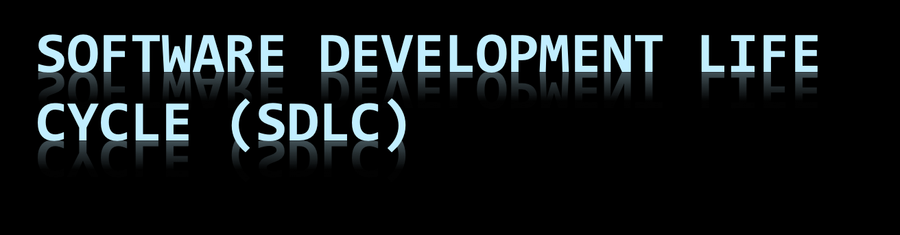
“You’ve got to be very careful if you don’t know where you’re going, because you might not get there.”
Ankur Jain

Slide 2
Capability Maturity Model (CMM)
A bench-mark for measuring the maturity of an organization’s software process
CMM defines 5 levels of process maturity based on certain Key Process Areas (KPA)

Slide 3
CMM Levels
Level 5 – Optimizing (< 1%)
  -- process change management
  -- technology change management
  -- defect prevention
Level 4 – Managed (< 5%)
  -- software quality management
  -- quantitative process management
Level 3 – Defined (< 10%)
  -- peer reviews
  -- intergroup coordination
  -- software product engineering
  -- integrated software management
  -- training program
  -- organization process definition
  -- organization process focus
Level 2 – Repeatable (~ 15%)
  -- software configuration management
  -- software quality assurance
  -- software project tracking and oversight
  -- software project planning
  -- requirements management
Level 1 – Initial (~ 70%)

Slide 4
SDLC Model
A framework that describes the activities performed at each stage of a software development project.

Slide 5
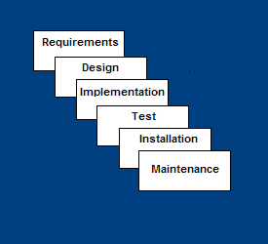
Waterfall Model
Requirements – defines needed information, function, behavior, performance and interfaces.
Design – data structures, software architecture, interface representations, algorithmic details.
Implementation – source code, database, user documentation, testing.

Slide 6
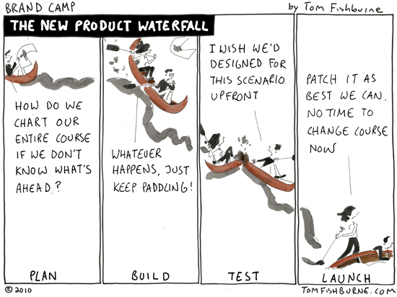

Slide 7
Waterfall Strengths
Easy to understand, easy to use
Provides structure to inexperienced staff
Milestones are well understood
Sets requirements stability
Good for management control (plan, staff, track)
Works well when quality is more important than cost or schedule

Slide 8
Waterfall Deficiencies
All requirements must be known upfront
Deliverables created for each phase are considered frozen – inhibits flexibility
Can give a false impression of progress
Does not reflect problem-solving nature of software development – iterations of phases
Integration is one big bang at the end
Little opportunity for customer to preview the system (until it may be too late)

Slide 9
When to use the Waterfall Model
Requirements are very well known
Product definition is stable
Technology is understood
New version of an existing product
Porting an existing product to a new platform.
  High risk for new systems because of specification and
  design problems.
  Low risk for well-understood developments using familiar technology.

Slide 10
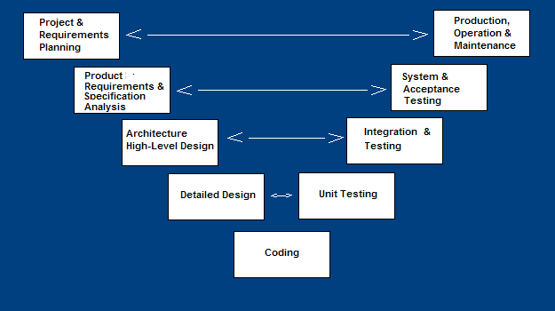
V-Shaped SDLC Model
A variant of the Waterfall that emphasizes the verification and validation of the product.
Testing of the product is planned in parallel with a corresponding phase of development

Slide 11
V-Shaped Steps
Production, operation and maintenance – provide for enhancement and corrections
System and acceptance testing – check the entire software system in its environment
Integration and Testing – check that modules interconnect correctly
Unit testing – check that each module acts as expected
Coding – transform algorithms into software
Project and Requirements Planning – allocate resources
Product Requirements and Specification Analysis – complete specification of the software system
Architecture or High-Level Design – defines how software functions fulfill the design
Detailed Design – develop algorithms for each architectural component

Slide 12
V-Shaped Strengths
Emphasize planning for verification and validation of the product in early stages of product development
Each deliverable must be testable
Project management can track progress by milestones
Easy to use

Slide 13
V-Shaped Weaknesses
Does not easily handle concurrent events
Does not handle iterations or phases
Does not easily handle dynamic changes in requirements
Does not contain risk analysis activities

Slide 14
When to use the V-Shaped Model
Excellent choice for systems requiring high reliability – hospital patient control applications
All requirements are known up-front
When it can be modified to handle changing requirements beyond analysis phase
Solution and technology are known

Slide 15
Protoyping: Basic Steps
Identify basic requirements
  Including input and output info
  Details (e.g., security) generally ignored
Develop initial prototype
  UI first
Review
  Customers/end –users review and give feedback
Revise and enhance the prototype & specs
  Negotiation about scope of contract may be necessary

Slide 16
Dimensions of prototyping
Horizontal prototype
  Broad view of entire system/sub-system
  Focus is on user interaction more than low-level system functionality (e.g. , databsae access)
  Useful for:
    Confirmation of UI requirements and system scope
    Demonstration version of the system to obtain buy-in from business/customers
    Develop preliminary estimates of development time, cost, effort

Slide 17
Dimensions of Prototyping
Vertical prototype
  More complete elaboration of a single sub-system or function
  Useful for:
    Obtaining detailed requirements for a given function
    Refining database design
    Obtaining info on system interface needs
    Clarifying complex requirements by drilling down to actual system functionality

Slide 18
Types of prototyping
Throwaway /rapid/close-ended prototyping
  Creation of a model that will be discarded rather than becoming part of the final delivered software
  After preliminary requirements gathering, used to visually show the users what their requirements may look like when implemented
Focus is on quickly developing the model
  not on good programming practices
  Can Wizard of Oz things

Slide 19
Fidelity of Protype
Low-fidelity
  Paper/pencil
    Mimics the functionality, but does not look like it

Slide 20
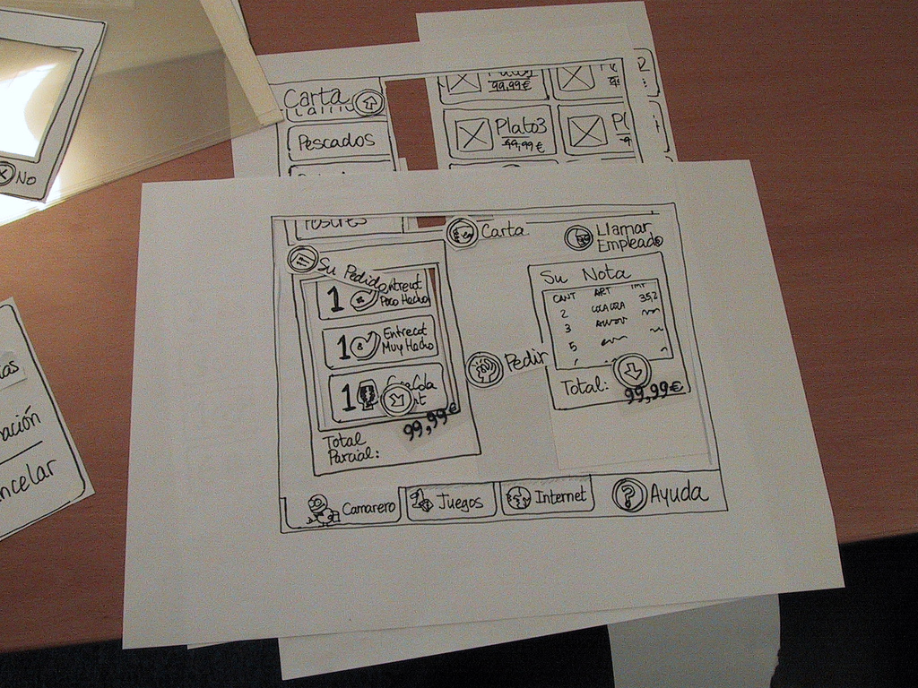

Slide 21
Fidelity of Protype
Medium to High-fidelity
  GUI builder
  “Click dummy” prototype – looks like the system, but does not provide the functionality
  Or provide functionality, but have it be general and not linked to specific data
  http://www.youtube.com/watch?v=VGjcFouSlpk
  http://www.youtube.com/watch?v=5oLlmNbxap4&feature=related

Slide 22
Throwaway Prototyping steps
Write preliminary requirements
Design the prototype
User experiences/uses the prototype, specifies new requirements
Repeat if necessary
Write the final requirements
Develop the real products

Slide 23
Evolutionary Prototyping
Aka breadboard prototyping
Goal is to build a very robust prototype in a structured manner and constantly refine it
The evolutionary prototype forms the heart of the new system and is added to and refined
Allow the development team to add features or make changes that were not conceived in the initial requirements

Slide 24
Evolutionary Prototyping Model
Developers build a prototype during the requirements phase
Prototype is evaluated by end users
Users give corrective feedback
Developers further refine the prototype
When the user is satisfied, the prototype code is brought up to the standards needed for a final product.

Slide 25
EP Steps
A preliminary project plan is developed
An partial high-level paper model is created
The model is source for a partial requirements specification
A prototype is built with basic and critical attributes
The designer builds
  the database
  user interface
  algorithmic functions
The designer demonstrates the prototype, the user evaluates for problems and suggests improvements.
This loop continues until the user is satisfied

Slide 26
EP Strengths
Customers can “see” the system requirements as they are being gathered
Developers learn from customers
A more accurate end product
Unexpected requirements accommodated
Allows for flexible design and development
Steady, visible signs of progress produced
Interaction with the prototype stimulates awareness of additional needed functionality

Slide 27
Incremental prototyping
Final product built as separate prototypes
At the end, the prototypes are merged into a final design

Slide 28
Extreme Prototyping
Often used for web applications
Development broken down into 3 phases, each based on the preceding 1
  Static prototype consisting of HTML pages
  Screen are programmed and fully functional using a simulated services layer
    Fully functional UI is developed with little regard to the services, other than their contract
  Services are implemented

Slide 29
Prototyping advantages
Reduced time and cost
  Can improve the quality of requirements and specifications provided to developers
    Early determination of what the user really wants can result in faster and less expensive software
Improved/increased user involvement
  User can see and interact with the prototype, allowing them to provide better/more complete feedback and specs
  Misunderstandings/miscommunications revealed
  Final product more likely to satisfy their desired look/feel/performance

Slide 30
Disadvantages of prototyping 1
Insufficient analysis
  Focus on limited prototype can distract developers from analyzing complete project
  May overlook better solutions
  Conversion of limited prototypes into poorly engineered final projects that are hard to maintain
  Limited functionality may not scale well if used as the basis of a final deliverable
    May not be noticed if developers too focused on building prototype as a model

Slide 31
Disadvantages of prototyping 2
User confusion of prototype and finished system
  Users can think that a prototype (intended to be thrown away) is actually a final system that needs to be polished
    Unaware of the scope of programming needed to give prototype robust functionality
  Users can become attached to features included in prototype for consideration and then removed from final specification

Slide 32
Disadvantages of prototyping 3
Developer attachment to prototype
  If spend a great deal of time/effort to produce, may become attached
  Might try to attempt to convert a limited prototype into a final system
    Bad if the prototype does not have an appropriate underlying architecture

Slide 33
Disadvantages of prototyping 4
Excessive development time of the prototype
  Prototyping supposed to be done quickly
  If developers lose sight of this, can try to build a prototype that is too complex
  For throw away prototypes, the benefits realized from the prototype (precise requirements) may not offset the time spent in developing the prototype – expected productivity reduced
  Users can be stuck in debates over prototype details and hold up development process

Slide 34
Disadvantages of prototyping 5
Expense of implementing prototyping
  Start up costs of prototyping may be high
  Expensive to change development methodologies in place (re-training, re-tooling)
  Slow development if proper training not in place
    High expectations for productivity unrealistic if insufficient recognition of the learning curve
  Lower productivity can result if overlook the need to develop corporate and project specific underlying structure to support the technology

Slide 35
Best uses of prototyping
Most beneficial for systems that will have many interactions with end users
The greater the interaction between the computer and the user, the greater the benefit of building a quick system for the user to play with
Especially good for designing good human-computer interfaces

Slide 36
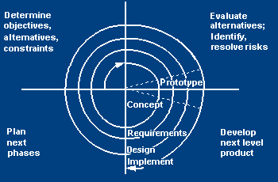
Spiral SDLC Model
Adds risk analysis, and 4gl RAD prototyping to the waterfall model
Each cycle involves the same sequence of steps as the waterfall process model

Slide 37
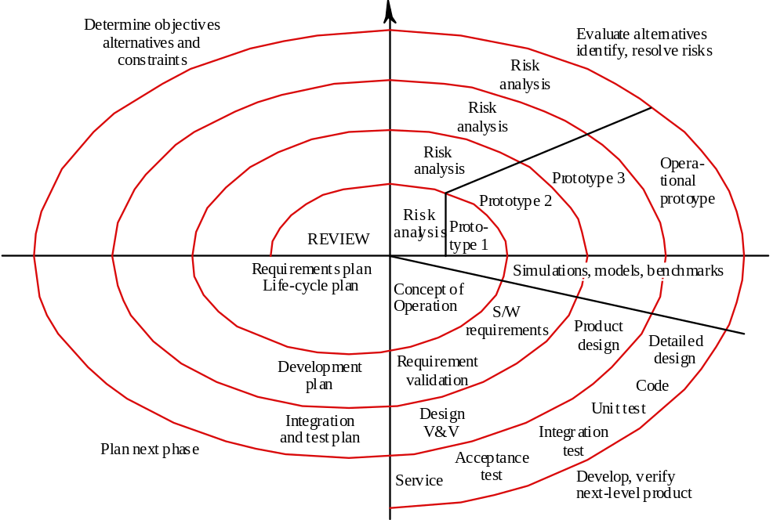

Slide 38
Spiral Quadrant: Determine objectives, alternatives and constraints
Objectives: functionality, performance, hardware/software interface, critical success factors, etc.
Alternatives: build, reuse, buy, sub-contract, etc.
Constraints: cost, schedule, interface, etc.

Slide 39
Spiral Quadrant: Evaluate alternatives, identify and resolve risks
Study alternatives relative to objectives and constraints
Identify risks (lack of experience, new technology, tight schedules, poor process, etc.
Resolve risks (evaluate if money could be lost by continuing system development

Slide 40
Spiral Quadrant: Develop next-level product
Typical activites:
  Create a design
  Review design
  Develop code
  Inspect code
  Test product

Slide 41
Spiral Quadrant: Plan next phase
Typical activities
  Develop project plan
  Develop configuration management plan
  Develop a test plan
  Develop an installation plan

Slide 42
Spiral Model Strengths
Provides early indication of insurmountable risks, without much cost
Users see the system early because of rapid prototyping tools
Critical high-risk functions are developed first
The design does not have to be perfect
Users can be closely tied to all lifecycle steps
Early and frequent feedback from users
Cumulative costs assessed frequently

Slide 43
Spiral Model Weaknesses
Time spent for evaluating risks too large for small or low-risk projects
Time spent planning, resetting objectives, doing risk analysis and prototyping may be excessive
The model is complex
Risk assessment expertise is required
Spiral may continue indefinitely
Developers must be reassigned during non-development phase activities
May be hard to define objective, verifiable milestones that indicate readiness to proceed through the next iteration

Slide 44
When to use Spiral Model
When creation of a prototype is appropriate
When costs and risk evaluation is important
For medium to high-risk projects
Long-term project commitment unwise because of potential changes to economic priorities
Users are unsure of their needs
Requirements are complex
New product line
Significant changes are expected (research and exploration)

Slide 45
Role Playing Game for SE’s
http://www.youtube.com/watch?v=kkkl3LucxTY&feature=related

Slide 46
Housekeeping
Individual Assignment:
  Post mortem + peer review
Final presentations/demos
  July 26/28 - 25 minutes per
    ~8 minute presentation
    ~10 minute demo
    ~7 minutes questions
Course evaluations this Thursday (4:05 pm)

Slide 47
The Rise and Fall of Waterfall
http://www.youtube.com/watch?v=X1c2--sP3o0&NR=1&feature=fvwp
Warning: bad language at 3:50! (hands over ears if easily offended!)

Slide 48
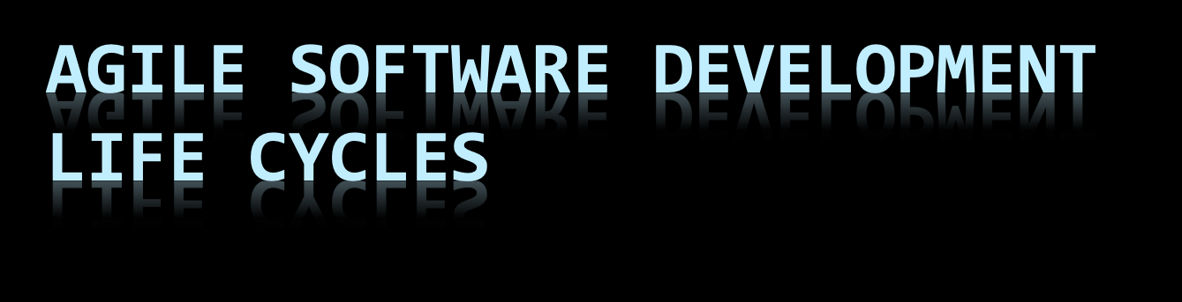

Slide 49
Agile SDLC’s
Speed up or bypass one or more life cycle phases
Usually less formal and reduced scope
Used for time-critical applications
Used in organizations that employ disciplined methods

Slide 50
Some Agile Methods
Rapid Application Development (RAD)
Incremental SDLC
Scrum
Extreme Programming (XP)
Adaptive Software Development (ASD)
Feature Driven Development (FDD)
Crystal Clear
Dynamic Software Development Method (DSDM)
Rational Unify Process (RUP)

Slide 51
Agile vs Waterfall Propaganda
http://www.youtube.com/watch?v=gDDO3ob-4ZY&feature=related

Slide 52
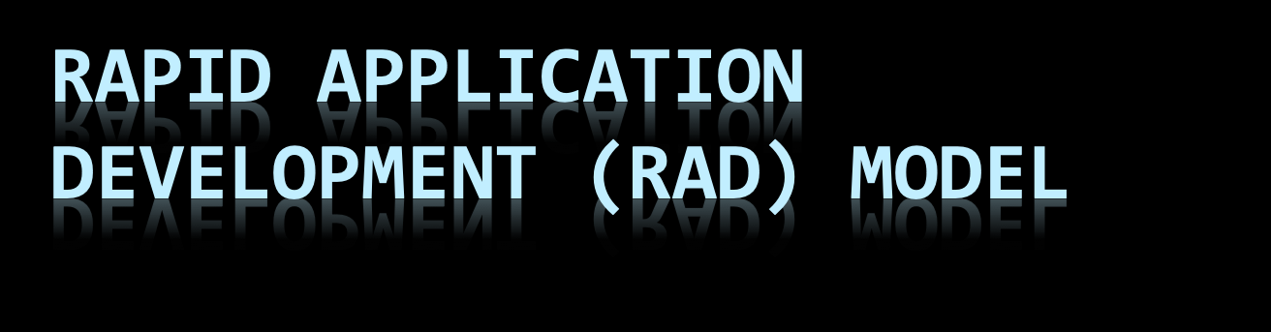

Slide 53
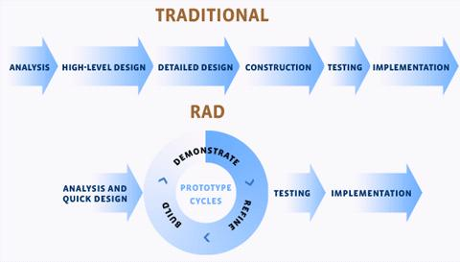

Slide 54
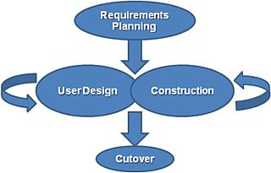

Slide 55
Rapid Application Model (RAD)
Requirements planning phase (a workshop utilizing structured discussion of business problems)
User description phase – automated tools capture information from users
Construction phase – productivity tools, such as code generators, screen generators, etc. inside a time-box. (“Do until done”)
Cutover phase -- installation of the system, user acceptance testing and user training

Slide 56
Requirements Planning Phase
Combines elements of the system planning and systems analysis phases of the System Development Life Cycle (SDLC).
Users, managers, and IT staff members discuss and agree on business needs, project scope, constraints, and system requirements.
It ends when the team agrees on the key issues and obtains management authorization to continue.

Slide 57
User Design Phase
Users interact with systems analysts and develop models and prototypes that represent all system processes, inputs, and outputs.
Typically use a combination of Joint Application Development (JAD) techniques and CASE tools to translate user needs into working models.
A continuous interactive process that allows users to understand, modify, and eventually approve a working model of the system that meets their needs.

Slide 58
JAD Techniques
http://en.wikipedia.org/wiki/Joint_application_design
CASE Tools
http://en.wikipedia.org/wiki/Computer-aided_software_engineering

Slide 59
Construction Phase
Focuses on program and application development task similar to the SDLC.
However, users continue to participate and can still suggest changes or improvements as actual screens or reports are developed.
Its tasks are programming and application development, coding, unit-integration, and system testing.

Slide 60
Cutover Phase
Resembles the final tasks in the SDLC implementation phase.
Compared with traditional methods, the entire process is compressed. As a result, the new system is built, delivered, and placed in operation much sooner.
Tasks are data conversion, full-scale testing, system changeover, user training.

Slide 61
RAD Strengths
Reduced cycle time and improved productivity with fewer people means lower costs
Time-box approach mitigates cost and schedule risk
Customer involved throughout the complete cycle minimizes risk of not achieving customer satisfaction and business needs
Focus moves from documentation to code (WYSIWYG).
Uses modeling concepts to capture information about business, data, and processes.
Notes:
imeboxing is a planning technique common in planning projects (typically for software development), where the schedule is divided into a number of separate time periods (timeboxes, normally two to six weeks long), with each part having its own deliverables, deadline and budget. Timeboxing is a core aspect of rapid application development (RAD) software development processes such as dynamic systems development method (DSDM) and agile software development.
Timeboxes are used as a form of risk management, especially for tasks that may easily extend past their deadlines. The end date (deadline) is one of the primary drivers in the planning and should not be changed as it is usually linked to a delivery date of the product. If the team exceeds the deadline, the team failed in proper planning and / or effective execution of the plan. This can be the result of: the wrong people on the wrong job (lack of communication between teams, lack of experience, lack of commitment / drive / motivation, lack of speed) or underestimation of the (complexity of the) requirements.
When the team exceeds the deadline, the following actions might be taken after conferring with the Client:
Dropping requirements of lower impact (the ones that will not be directly missed by the user)
Working overtime to compensate for the time lost
Moving the deadline

Slide 62
RAD Weaknesses
Accelerated development process must give quick responses to the user
Risk of never achieving closure
Hard to use with legacy systems
Requires a system that can be modularized
Developers and customers must be committed to rapid-fire activities in an abbreviated time frame.

Slide 63
When to use RAD
Reasonably well-known requirements
User involved throughout the life cycle
Project can be time-boxed
Functionality delivered in increments
High performance not required
Low technical risks
System can be modularized

Slide 64
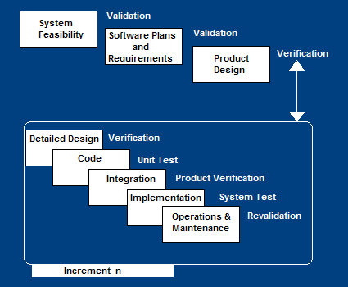
Incremental SDLC Model
Construct a partial implementation of a total system
Then slowly add increased functionality
The incremental model prioritizes requirements of the system and then implements them in groups.
Each subsequent release of the system adds function to the previous release, until all designed functionality has been implemented.

Slide 65
Incremental Model Strengths
Develop high-risk or major functions first
Each release delivers an operational product
Customer can respond to each build
Uses “divide and conquer” breakdown of tasks
Lowers initial delivery cost
Initial product delivery is faster
Customers get important functionality early
Risk of changing requirements is reduced

Slide 66
Incremental Model Weaknesses
Requires good planning and design
Requires early definition of a complete and fully functional system to allow for the definition of increments
Well-defined module interfaces are required (some will be developed long before others)
Total cost of the complete system is not lower

Slide 67
When to use the Incremental Model
Risk, funding, schedule, program complexity, or need for early realization of benefits.
Most of the requirements are known up-front but are expected to evolve over time
A need to get basic functionality to the market early
On projects which have lengthy development schedules
On a project with new technology

Slide 68


Slide 69
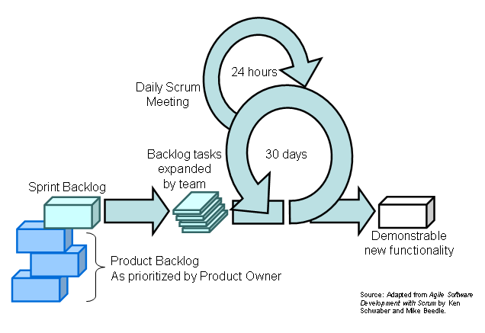
Scrum:

Slide 70
Scrum in 13 seconds:
  http://www.youtube.com/watch?v=9DKM9HcRnZ8&feature=related
Scrum in 10 minutes:
  http://www.youtube.com/watch?v=Q5k7a9YEoUI
More scrum slides:
  http://www.mountaingoatsoftware.com/system/presentation/file/129/Getting-Agile-With-Scrum-Cohn-NDC2010.pdf?1276712017
  Scalability of scrum addressed on slides 33-35

Slide 71
Scrum advantages
Agile scrum helps the company in saving time and money.
Scrum methodology enables projects where the business requirements documentation is hard to quantify to be successfully developed.
Fast moving, cutting edge developments can be quickly coded and tested using this method, as a mistake can be easily rectified.

Slide 72
Scrum advantages
It is a lightly controlled method which insists on frequent updating of the progress in work through regular meetings. Thus there is clear visibility of the project development.
Like any other agile methodology, this is also iterative in nature. It requires continuous feedback from the user.
Due to short sprints and constant feedback, it becomes easier to cope with the changes.

Slide 73
Scrum advantages
Daily meetings make it possible to measure individual productivity. This leads to the improvement in the productivity of each of the team members.
Issues are identified well in advance through the daily meetings and hence can be resolved in speedily
It is easier to deliver a quality product in a scheduled time.

Slide 74
Scrum advantages
Agile Scrum can work with any technology/ programming language but is particularly useful for fast moving web 2.0 or new media projects.
The overhead cost in terms of process and management is minimal thus leading to a quicker, cheaper result.

Slide 75
Scrum disadvantages
Agile Scrum is one of the leading causes of scope creep because unless there is a definite end date, the project management stakeholders will be tempted to keep demanding new functionality is delivered.
If a task is not well defined, estimating project costs and time will not be accurate. In such a case, the task can be spread over several sprints.
If the team members are not committed, the project will either never complete or fail.

Slide 76
Scrum disadvantages
It is good for small, fast moving projects as it works well only with small team.
This methodology needs experienced team members only. If the team consists of people who are novices, the project cannot be completed in time.
Scrum works well when the Scrum Master trusts the team they are managing. If they practice too strict control over the team members, it can be extremely frustrating for them, leading to demoralisation and the failure of the project.

Slide 77
Scrum disadvantages
If any of the team members leave during a development it can have a huge inverse effect on the project development
Project quality management is hard to implement and quantify unless the test team are able to conduct regression testing after each sprint.

